Slide 1
ABOUT
ALCOHOL
© Copyright 2019, Saskatchewan Prevention Institute
RESOURCE 3-148 09/2019
Notes:
This presentation was created by the Saskatchewan Prevention Institute.
The Saskatchewan Prevention Institute is a non-profit organization that works to reduce the occurrence of disabling conditions in children, including Fetal Alcohol Spectrum Disorder (FASD).
The Prevention Institute raises awareness by providing training, information, and resources that are based on current best evidence.
Programs include:
Child Injury Prevention
Child Traffic Safety
Community Action Program for Children
Early Childhood Mental Health
Fetal Alcohol Spectrum Disorder Prevention
Maternal and Infant Health
Nobody’s Perfect Parenting
Sexual and Reproductive Health

Slide 2
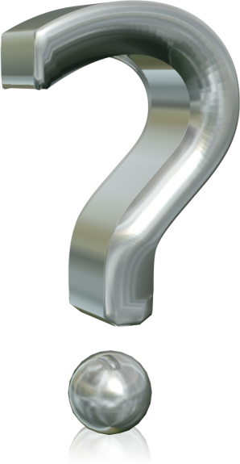
Why talk about alcohol?
Notes:
Alcohol is very popular in Canada, but did you know that alcohol is a drug?
Alcohol is a depressant drug that can slow down the parts of the brain that affect thinking, behaviour, breathing, and heart rate.
Alcohol is the most commonly used drug in Canada. In Saskatchewan, the legal age for drinking alcohol is 19.
It’s important to talk about alcohol so we know what it really is, what happens when we drink it, and how it impacts us and our community.
Alcohol comes in all sorts of colours and textures. It can be clear (e.g., vodka, gin), coloured (e.g., wine), or dark brown (e.g., stout or dark lager beer). Most of the time people drink alcohol as a liquid. It is sometimes a solid such as gelatin shots, or can be put into fruit. It can also be inhaled as a vapour. The scientific name for the alcohol we drink is ethanol.
Alcohol can also be found in mouthwashes, aftershave lotions, or rubbing alcohol. Drinking these products can cause an overdose and poisoning.
A different type of alcohol, known as methanol, is found in hairspray, paint removers, and anti-freeze. This type of alcohol is poisonous and should never be swallowed as it can be deadly.

Slide 3
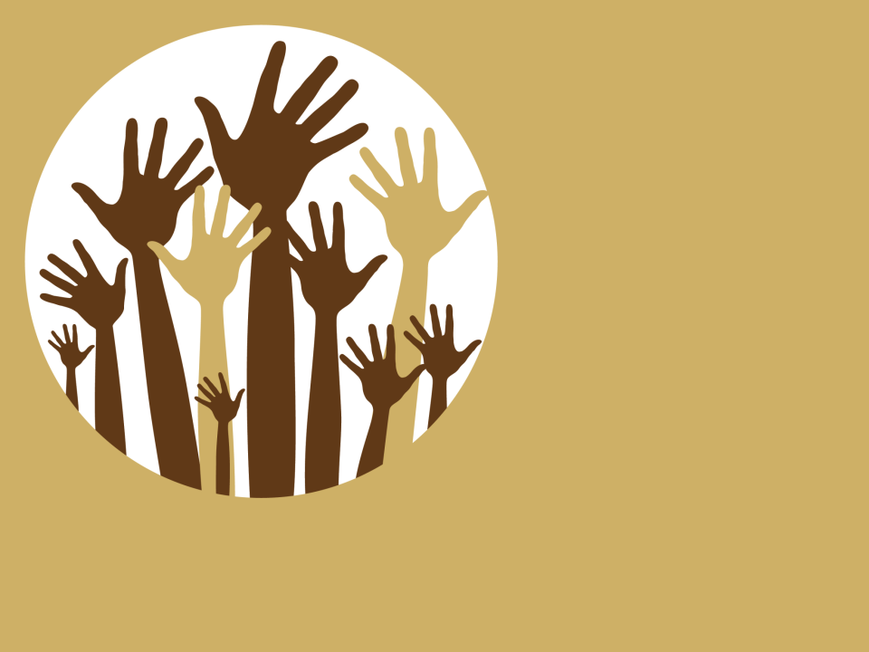
Canadians said they drank alcohol in the past year.
8
ABOUT
10
IN
Notes:
Most Canadians drink alcohol. In 2017, almost 78% of Canadians, 15 years and over, reported drinking alcohol in the last year. This is about 8 out of 10 Canadians. That also means that 2 out of 10 Canadians did not drink any alcohol in the last year.
Many people under report their alcohol use so people are using more alcohol than reported.
Some people don’t drink at all; some are light social drinkers; some drink hard sometimes but not all the time; and some drink every day. Some people used to drink, but for one reason or another, have stopped drinking.
Why do people drink?
They may drink to socialize with friends, family, and work colleagues.
They may drink with meals to accompany food.
They may drink to relax.
They may drink because they like how it tastes and makes them feel.
Some drink because they are feeling stress.
Some drink because they are happy and celebrating something.
Some drink because of peer pressure or wanting to fit in.
Some drink because they are feeling sad (negative emotions).
Some drink because they are bored.
Some drink because they want to get drunk.
Some drink because they are trying to numb painful memories or trauma.
Some people drink because they depend on alcohol.
Some people drink because they have a substance use disorder.
Sometimes parents, other adults, and older brothers and sisters can act as role models for children and youth, passing on risky drinking patterns to the next generation.
Some are coping with emotional problems, trying to reduce stress, or lose weight.
Some want to bond with friends, relieve boredom, or improve their sense of self.
They are influenced by ads they see for alcohol online, television, or in magazines and on billboards.
Many sporting events are sponsored by alcohol.
Discussion: Where do people drink? Obtain responses from participants.
Examples of answers are:
Parties – in homes, outdoors, community centres
Weddings, birthdays, and other celebrations
Bars, clubs, pubs
Watching sports events – hockey, baseball, etc.
After playing sports – team drinking after games
Restaurants
At home with friends
At home by themselves
Music festivals
People who don’t drink often feel pressured to drink. They are often asked why they aren’t drinking. This can be especially difficult for someone who has quit drinking because of alcohol dependency, or for a woman who is pregnant but not ready to tell people.
Activity: Sleep. Alcohol. Drunk.
Ask:
What are other words for sleep? Or work? (Pick one everyday thing we do.)
What are other words for alcohol? (e.g., booze, cold one, juice, hooch, vino, and moonshine)
What are some words for drunk? (e.g., sloshed, pickled, pissed, tanked)
(Quite often there are more words for drunk than there are for sleep. This shows that alcohol is very popular.)

Slide 4
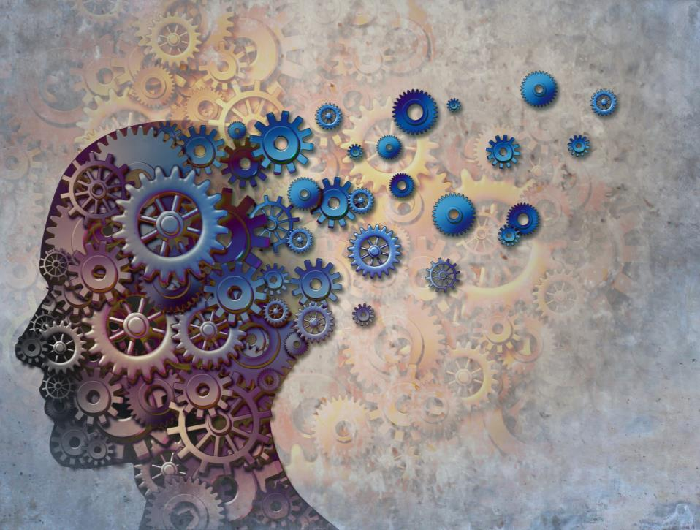
How does alcohol work?
Notes:
When a person drinks, the stomach and small intestine absorb the alcohol. The stomach and small intestine spread the alcohol to the entire body. This happens quickly because alcohol molecules are very tiny and can dissolve in water.
The rate at which alcohol moves into the bloodstream is influenced by how much food a person has eaten. If the stomach is empty, the alcohol will pass into the bloodstream right away and a person will feel its effects more quickly. If there is solid food in the stomach, it will take longer.
The amount of alcohol circulating in the bloodstream is called the blood alcohol concentration (BAC). The more alcohol a person drinks, the higher his BAC and the more drunk that person will become.
Other things that affect the BAC include:
how quickly a person drinks
having food in the stomach
a person’s body size
age
genetics
sex (male or female)
Once alcohol is in the bloodstream, it travels through the body to different organs. It goes quickly to the organs with many blood vessels, such as the brain, the lungs, and the liver.
The effects in the brain are seen first. It can change a person’s judgement, attention span, memory, and reaction time. It also slows down muscle movement and speech.
When too much alcohol is used, a person gets drunk. This can lead to a greater chance of alcohol-related harms. In extreme cases, more drinking can lead to alcohol poisoning and death.

Slide 5
Notes:
As mentioned before, alcohol is a drug and can cause harm to our bodies.
Alcohol is a carcinogen. It can cause cancer. Alcohol has been linked to 7 different types of cancer including breast and liver cancers.
Alcohol is also a teratogen. It can harm the cells of a developing fetus (unborn baby). A fetus exposed to alcohol may have birth defects.
There is a saying, “What’s your poison?” that is used to ask people what type of alcoholic drink they want. When we think about alcohol’s impact, this question “What’s your poison?” may be pretty truthful.
When talking about alcohol, it is good to look at both the good and the not so good.

Slide 6
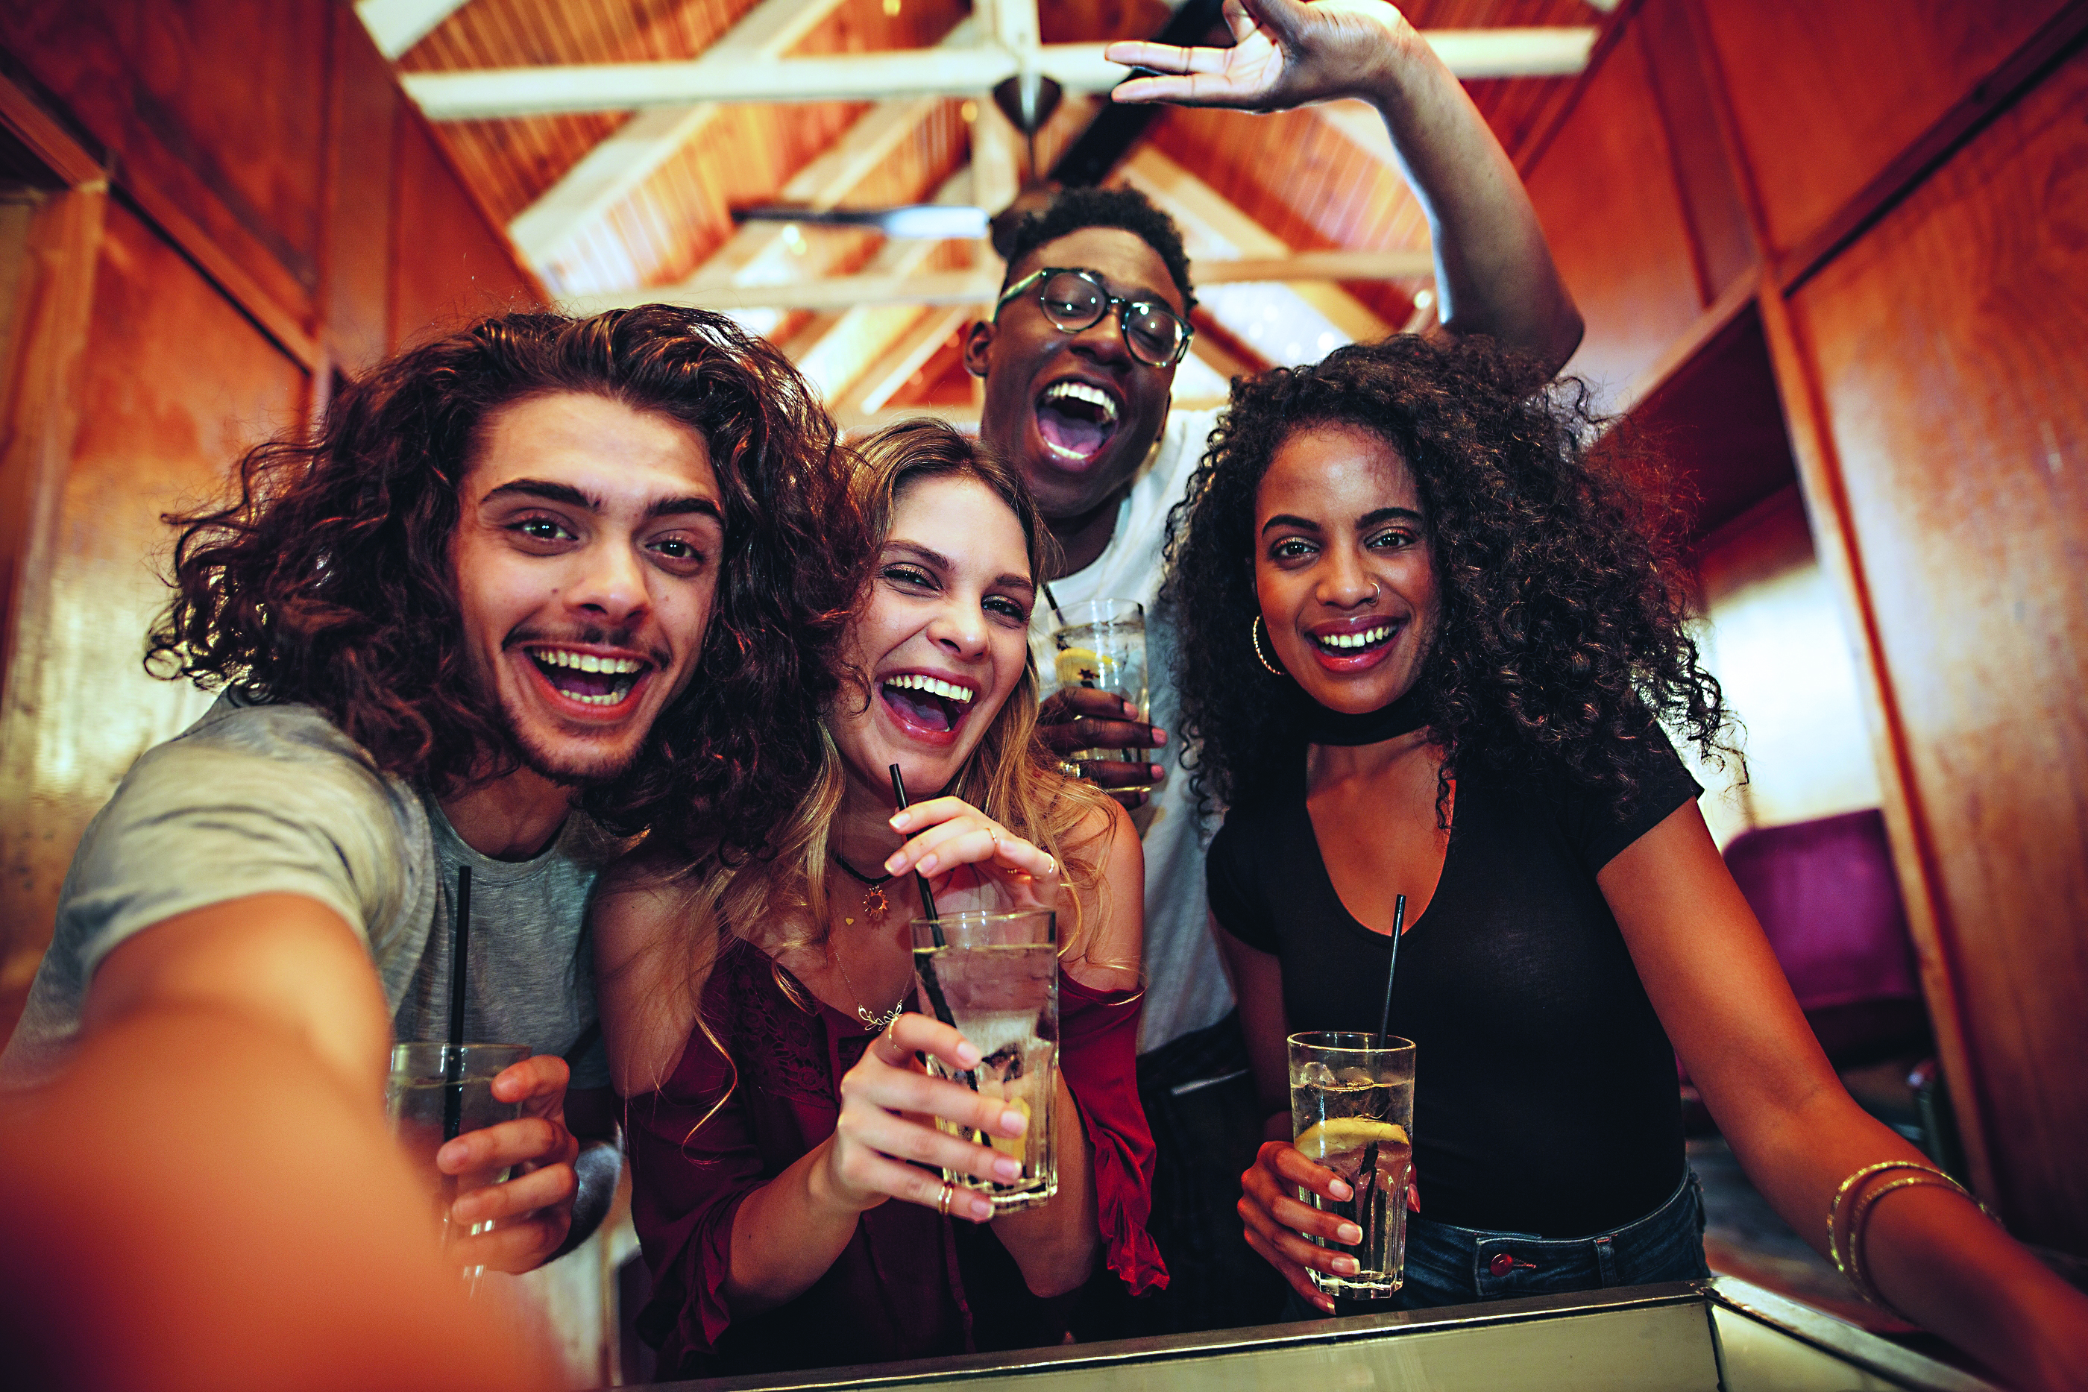
Perceived Benefits of Alcohol
Notes:
First, we will look at the perceived benefits (what people may feel are benefits).
People may give these reasons for drinking:
Forming new friendships and strengthening existing ones
Being social, enjoying and having positive social experiences
Being part of a cultural tradition
Having a positive mood, and having positive mental well-being
Reducing stress
Improving mental health
Having fun
Celebrating, feeling sophisticated, and feeling good
Relaxing
Some people think a drink can be good for their health. Evidence suggests that the benefits from drinking alcohol are not relevant for all individuals, at all ages, or in all situations.
For young people, there are no health benefits to using alcohol. The potential health benefits from alcohol do not begin until middle age.

Slide 7
Short-term Harms of Alcohol
Notes:
Now that we have looked at what people may see as benefits of drinking, we will look at harms of alcohol, both immediate and over time. Alcohol-related harms across Canada are on the rise. The risk of an injury grows with every additional drink a person has.
Activity with sticky notes. Ask people to write harms on the notes and place on a specified location. Read the harms participants have given.
Harms that can happen when drinking are:
Getting drunk, throwing up
Memory loss, blackouts
Alcohol overdose, poisoning, death
Social/relationship troubles (arguing, fighting)
Violence
Family problems
Crime
Murder
Regretful behaviour
Abuse
Car crashes
Unplanned sex
Unwanted sex
Unprotected sex
Mental health issues, like addictions, depression, suicide
Injuries
Getting arrested and having legal problems, like DUIs, losing one’s driver’s license
Unplanned pregnancies
Greater risk of getting a sexually transmitted infection from unprotected sex
Using other drugs
In Canada, alcohol is the top risk factor for poor health among Canadians aged 15 to 49 years.

Slide 8
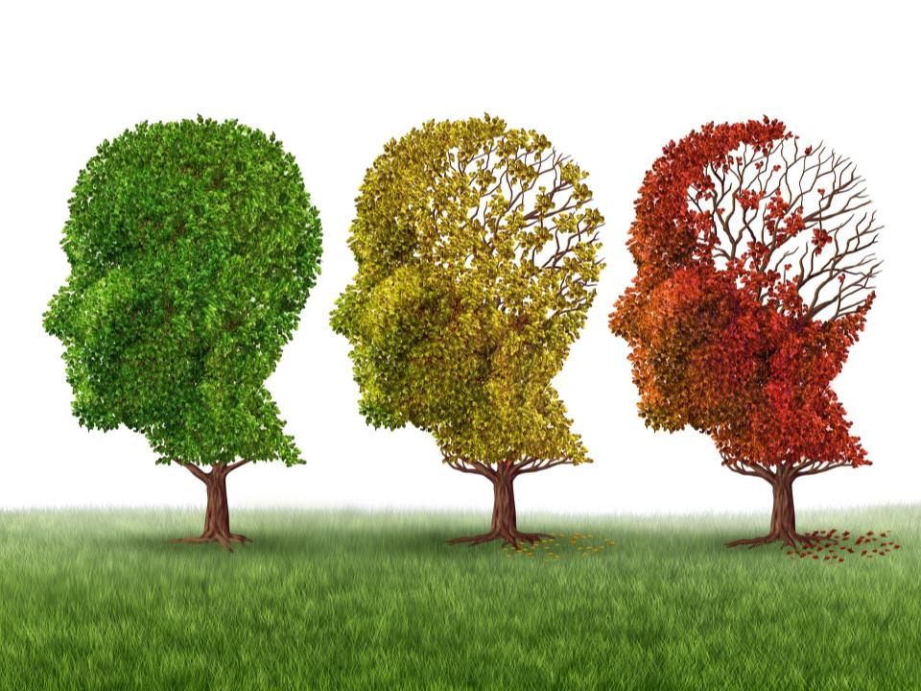
Long-term Harms of Alcohol
Notes:
Over time, there can be long-term problems because of drinking.
Discussion: Brainstorm some of the long-term harms that might happen. Answers might include the following:
Alcohol use disorders
Greater risk of several types of cancer
Health problems such as diabetes, cirrhosis of the liver, strokes, pancreatitis, and heart problems
Liver disease
Fetal Alcohol Spectrum Disorder
Learning and memory problems leading to dropping out of school, money problems
Mental health problems (e.g., depression, anxiety, and suicide)
Social, school, work, and money problems (e.g., family problems, work problems from poor attendance or poor performance, unemployment, failing or quitting school)
Trouble getting pregnant – infertility (unable to have a baby)
Weakened immune system (get sick more often)
One of the long-term harms from drinking alcohol during pregnancy can be for the child, who can experience life-long problems with their brain and body, known as FASD.

Slide 9
Alcohol and Young People
Notes:
Discussion: What is happening in your community with young people and alcohol? Obtain responses from participants.
In Canada, young people drink alcohol. Many youth start drinking when they are in their teens. In fact, the average age for students to try drinking was 13. In 2016-2017, more than 40% (44%) of students in grades 7 to 12 reported drinking an alcoholic beverage in the past 12 months. That is 2 out of 5 students.
Almost 1 in 4 students had 5 or more drinks on a single occasion. This is risky drinking.
The average age when students started drinking was 13.
A Canadian national alcohol use survey showed younger drinkers under-report alcohol use more than older drinkers. Drinking and amount drunk by young people may be higher than the numbers tell us.
It is also good to remember that these statistics also show us that 3 out of 5 students did not report drinking alcohol in the past 12 months.
Why do young people drink?
They drink for many of the same reasons as adults. Some reasons are:
Having fun
Feeling good
Being social
Celebrating
Liking the taste
Drinking games
Easy to get
Coping with stress or pain
Feeling down or sad
Coping with negative situations
Coping with trauma
Discrimination
Having a family history of substance use and/or a mental illness
It is healthier for teens not to drink until they are older. Why is this?
Activity: Brainstorm a list of problems teens can have using alcohol. Answers may include:
Problems with family
Social problems
School – missing classes, lower grades, failure, drop out
Physical problems – injuries, hangover, being sick, etc.
Alcohol can harm all parts of the developing brain. The human brain continues to mature throughout adolescence and well into a person’s 20s. In particular, the prefrontal cortex of the teen brain is under rapid development. This part of the brain is the control centre for making decisions, understanding and using what we learn, and problem solving. With all the changes happening in the brain during this time, alcohol use can affect brain function, thinking, and behaviour, as well as attention, learning, and memory.
When people start drinking early, they are more likely to get hurt by their alcohol use than if they wait until they are older. Teens who start to drink at a young age often have a higher chance of developing problems with alcohol, such as becoming dependent or addicted. They can also develop learning and memory problems, and have a higher chance of developing certain chronic diseases.
Problem drinking can happen for many reasons. Some of them are:
Marketing
How easy it is to get alcohol
Family relationships
Relationships with peers
Experiences of abuse and trauma
Lack of stable housing
Family income
Too much and risky drinking can affect youth in many ways. This includes the chance of:
Injury
Memory loss
Unwanted sex
Assaults
Suicide
Self-harm
Alcohol poisoning
Car crashes
Fights
Arguments with their friends or family members
Having problems with school
Some subgroups of young people seem to be at a higher risk for substance use and related problems. This includes young people who are:
Homeless and street-involved
Indigenous
LGBTQ
In the justice system
Living with co-occurring mental health problems
Have a history of trauma
There are influences that can help protect or help build resilience in young people: These include the following:
Feeling connected to school
Positive relationships with caring adults inside and outside the family
Supportive peers
School and community safety

Slide 10
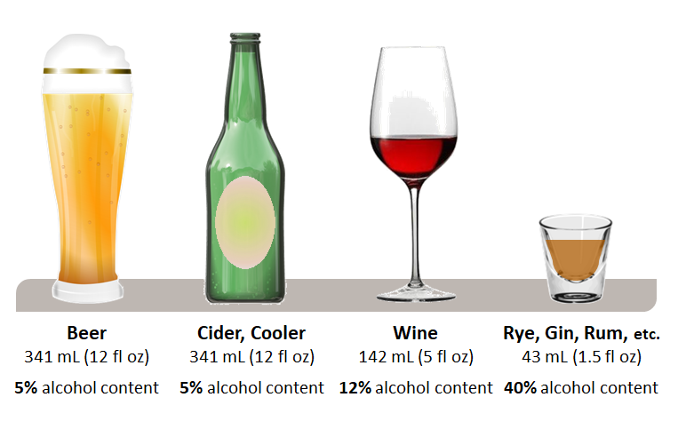
What is a standard drink?
This Photo by Unknown Author is licensed under CC BY
Notes:
Now that various problems related to alcohol have been discussed, what are ways to reduce these impacts?
Canadian researchers and doctors looked at the research about alcohol and developed Canada’s Low-Risk Alcohol Drinking Guidelines. These guidelines give us information to lower our risk if we choose to drink alcohol.
As part of Canada’s Low-Risk Alcohol Drinking Guidelines, researchers calculated standard drink sizes. Using a standard sizing helps us to measure our drinks and then we can count the number of drinks we have. This allows us to keep track of our drinking and set limits for ourselves. Essentially, we can make informed choices and control our drinking.
It is not always easy to know how much to pour to make a standard drink.
Activity: Pour a Drink
Set out a variety of glasses used for drinks, pitcher of water, and a measuring cup. The purpose of this activity is to demonstrate how hard it is to pour a drink that is a standard size.
Ask for a volunteer. Give him or her a container full of water and an empty wine glass Ask him or her to pour you a glass of “wine” (water).
Then, pour the glass of “wine” into the measuring cup to measure how much was poured.
You can also have the volunteer pour 1.5 ounce drink and a “beer” in the different sizes of glasses. You can discuss how difficult it can be to judge the size of a drink. That is one reason some people may be drinking more alcohol than they think they are drinking.
In Canada, a standard drink has 14 grams (about 0.6 fluid ounces) of pure alcohol. This is generally equal to one bottle of beer, most coolers (although some are higher alcohol content and are more than one standard drink), a 5-ounce glass of wine, and 1-½ ounces of hard alcohol.
Each of the drinks in this picture has the same amount of pure alcohol. Many people think that one type of alcoholic drink may have less alcohol and be safer than other types. One type is no safer than another – that goes for beer, wine, cider, liqueurs, or hard alcohol.

Slide 11
Canada’s Low-Risk Alcohol Drinking Guidelines
Notes:
Hand out brochures.
Show YouTube Video: “Understanding Canada’s Low-Risk Alcohol Drinking Guidelines” (3:08) https://www.bing.com/videos/search?q=low+risk+alcohol+drinking+guidelines+youtube&view=detail&mid=4A210BD34F3EF92E87A44A210BD34F3EF92E87A4&FORM=VIRE
If you choose, you may skip the video and talk about the guidelines:
Women
No more than 2 drinks/day
No more than 10 drinks/week
One or two non-drinking days/week so drinking doesn’t become a habit
Men
No more than 3 drinks/day
No more than 15 drinks/week
One or two non-drinking days/week so drinking doesn’t become a habit
There are recommendations about when people should not drink at all, such as the following:
When driving a vehicle, using machinery and tools
When taking medications or drugs that interact with alcohol
When doing dangerous physical activity (e.g., sky diving)
When living with some mental or physical health problems
When living with alcohol dependence
When pregnant or planning to become pregnant
When responsible for the safety of others
When making important decisions (signing your will, buying a house)
The Low-Risk Alcohol Drinking Guidelines give advice to young people as well. They suggest delaying drinking as long as possible – until age 24 if possible. This will reduce harm to a young person’s brain and body. They also suggest that young people should talk to their parents about drinking. If young people drink, they should do so under parental guidance; never more than 1-2 drinks at a time, and never more than 1-2 times per week.

Slide 12
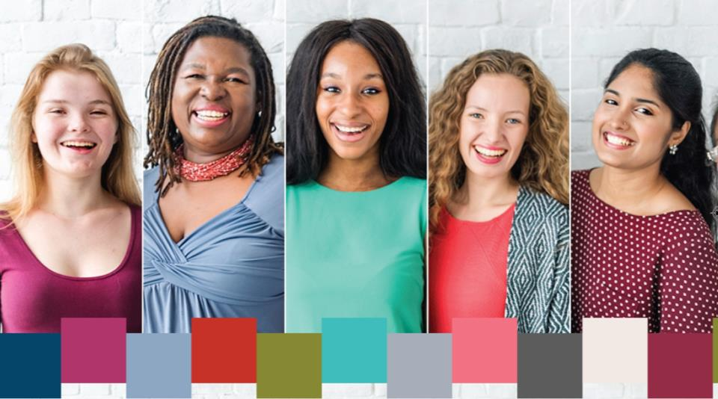
Why are the amounts different for women?
Notes:
Women’s bodies deal with alcohol differently.
A woman has less water content in her body than a man. Water helps to weaken or “water down” alcohol. Therefore, a man’s body can dilute alcohol more efficiently.
Women have lower concentrations of an enzyme (dehydrogenase) that breaks down alcohol before it passes into the blood stream. Therefore, a woman’s body takes longer to process alcohol than a man’s body.
Women often weigh less than men and people who weigh less reach higher BAC levels than those who weigh more when consuming the same amount of alcohol.
Women have a higher body fat content than men. Body fat does not absorb alcohol, so alcohol content remains higher in women. Because of this, women often feel drunk faster than men.

Slide 13
Range of Drinking Patterns
Non-drinker
Social drinker
Habitual
Elevated or risky drinking
Alcohol abuse
Alcohol dependence
Substance use disorder
Notes:
There are a lot of terms used to describe ways of drinking. Some of the terms, particularly for challenges with alcohol, raise stigma and can make it more difficult to talk about alcohol use. Language is changing around some of these terms.
Some people do not drink alcohol.
Other people may drink once-in-awhile with friends or when having a meal. It may be part of their social life.
Drinking alcohol can become a habit for people. Some people drink more than the recommended levels.
People who abuse alcohol may not be dependent on alcohol but they can have family, work, or school problems because of their drinking. Their drinking may lead to risky behaviour and they may use poor judgement.
People can become dependent on alcohol – where they feel they need it. The terms dependence or addiction are often used.
Addiction is a physical need that is hard to control. A person builds up a tolerance, and it takes more and more alcohol to feel the same effects. People who have an alcohol addiction go through physical and mental problems when they don’t have something to drink. This is called withdrawal. The word addict or addiction can make it sound like there is no hope so substance use disorder is now used.
A substance use disorder often becomes socially harmful: the person does anything to get alcohol and to drink. It begins to interfere with relationships, work, school, and other parts of the person’s life.
A substance use disorder can cut someone off from family and friends, their culture, and community. It also has an impact on family members. It is very difficult to watch a loved one struggling. There is often a feeling of frustration; “If they would just quit or get help, things would get better.” However, dealing with dependence is not simple.

Slide 14
What is risky drinking?
4
5
Women
Men
Notes:
How many drinks does it take to be considered risky or binge drinking?
Facilitated Discussion: “How much do you think someone has to drink to be considered risky drinking?”
It may surprise you to know that risky drinking, or binge drinking, is considered 5 or more standard drinks for men, and 4 or more standard drinks for women, during one occasion. Some examples of occasions might be a wedding reception, a family dinner, a party, an evening playing cards with friends, or drinking at a bush party.
Risky drinking increases the risk of alcohol-related harms like the ones talked about earlier. For young people, binge drinking is more likely to cause:
blackouts
hangovers
behaviour they regret
arguing or fighting
becoming sick
injuring themselves
stealing or damaging property)
unplanned or unintended sex
passing out
alcohol poisoning
being emotional
unknown physical injuries
spending more than planned
Some of the lasting effects of underage binge drinking include:
slowed motor skills
difficulty learning new ideas
problems making decisions
decreased abilities in sports
health-related problems (e.g., cancer, cardiovascular disease)
alcoholism as adults
trouble with the law
Risky or binge drinking when pregnant increases the harm to the fetus.

Slide 15
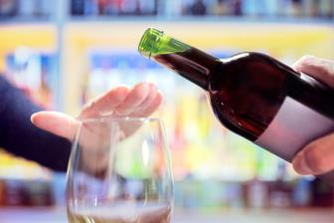
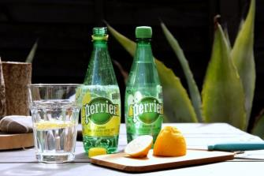
Safer Drinking Tips
Stay within your limits
Drink slowly
Have non-alcoholic beverages between drinks with alcohol
Eat food
Notes:
The Low-Risk Alcohol Drinking Guidelines provide some safer drinking tips in the brochure. Ideas include the following:
Set limits for drinking and stick to them.
Drink slowly. Have 2 drinks or less in a 3-hour period.
Alternate between alcoholic and non-alcoholic drinks.
Eat before and while drinking.
Think about your age, weight, and health issues and if cutting back on drinking or not drinking at all might be the best idea.
Benefits of following the guidelines can include the following:
Better sleep
No more hangovers
Better fitness
Better weight management (Alcohol has calories!)
More designated driver options
More patience
Drinking quality instead of quantity
Better ability to concentrate

Slide 16
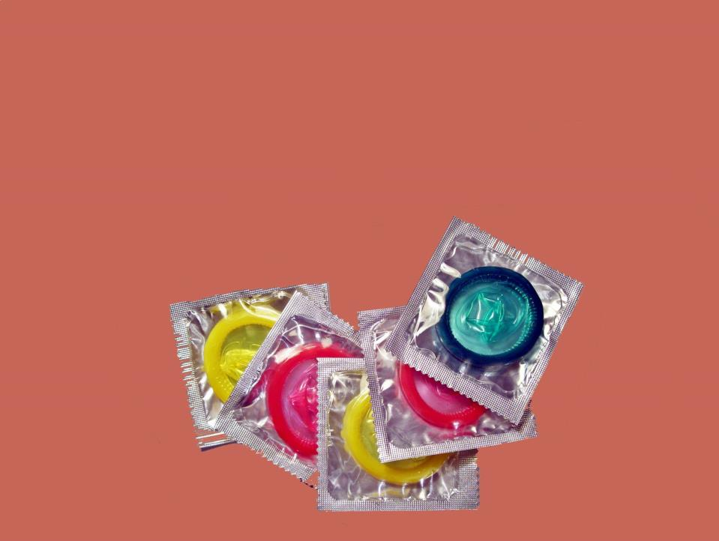
What have you heard about alcohol and sex?
Notes:
Participant discussion: Ask Question: “What have you heard about alcohol and sex?”
Reflect back what you hear from people.
Alcohol and sex seem to go together. Alcohol can act like a “social lubricant” which means people are a little braver and may connect with others. They may feel less inhibited while drinking. When people have been drinking, they are not as responsible about organizing or insisting on protection to prevent sexually transmitted infections (STIs) and pregnancy. Young people, in particular those who used drugs or drank before having sex, were less likely to use a condom than if they were sober.
When people do not use protection, they can get sexually transmitted infections.
When people do not use protection, there may be an unplanned pregnancy. Approximately half of all pregnancies are unplanned. Young people (under the age of 25) who become pregnant are more likely to have unplanned pregnancies than those over 25. If a female does not know she is pregnant and continues to drink, the fetus will be accidentally exposed to alcohol.
Children are a gift. Yet many people are not ready to be parents, especially young people. Teenagers are going through their own developmental issues, struggling with hormones and figuring out who they are. Some adults aren’t ready to become parents either – they may be struggling with things of their own or it might not be the best timing.
When young people have children too early, their babies are more likely to weigh less and be born early (prematurely). Young moms don’t always get as much prenatal care. This may increase the chances of bad health outcomes, including infant death and poor health for the child.
This does not mean all teenagers who have babies have unhealthy pregnancies or do a bad job of parenting. Some are very responsible, have healthy pregnancies, and are good parents. It is best for everyone, no matter the age, if our children are planned to come along at a time that works best for the parents.

Slide 17
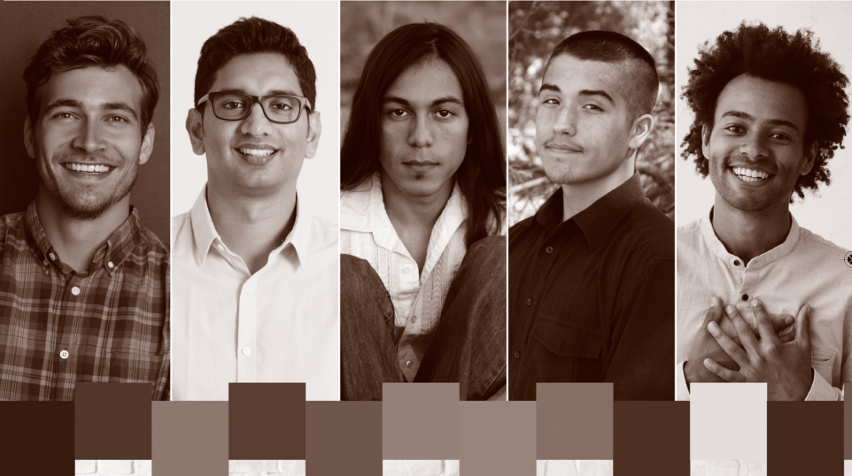
Men and Alcohol
Notes:
Generally, males start to drink earlier than females. Males in all age groups drink more than women. However, women are catching up in their drinking. Men also do more risky drinking than females. More males than females drink in patterns that exceeded the low-risk alcohol drinking guidelines.
Men drink more for positive effects and social aspects than women.
Here is some information about men and alcohol.
Males’ reasons for alcohol use are tied to bonding with friends, relieving boredom, or enhancing their sense of self.
Among drivers in fatal motor-vehicle traffic crashes, men are approximately 1.5 times as likely as women to have been over the legal limit.
Men have a higher risk of colorectal cancer.
Males age 20 and older are more likely to be hospitalized for conditions entirely caused by alcohol than females.
Men have much higher rates of emergency department visits related to alcohol.
Men have higher rates of alcohol-related deaths than women.
Risky drinking is commonly involved in sexual assault.
Alcohol use by men increases the chances of having unprotected sex, sex with multiple partners, or sex with a partner at risk for sexually transmitted infections.
Alcohol use can cause impotence and infertility.
Risky drinking increases violence and the risk of physically assaulting another person.
Men are more likely than women to die by suicide, and more likely to have been drinking before they died.

Slide 18
More women and girls are drinking.
Notes:
Alcohol is the most commonly used substance among females. Women and girls are drinking more than they used to drink and are catching up to males in their drinking. They are also drinking alcohol in more harmful patterns. As drinking increases, risks increase. Women are more vulnerable to the effects of alcohol. Between 2003 and 2016, there was a greater increase in the alcohol-related visits to emergency departments experienced by women as compared to men.
In the past, since women were not drinking as much as men, there were fewer negative impacts. Now, the rate of alcohol-related hospitalizations and deaths is growing faster for women than for men.
Facilitated Discussion: Why do you think this is happening? Obtain responses from participants.
Women often drink differently than men and for different reasons. Females drink for reasons such as:
coping with emotional problems
reducing stress
coping with eating disorders
more permissive drinking norms and values for and among women
having more education
being in the work force
wanting to feel more affectionate, sexy, and feminine
living with trauma (e.g., victim of sexual abuse)
being influenced by marketing by the alcohol industry
The alcohol industry has marketed their products to young people and women as a way to increase profits. Many children, young people, and other vulnerable groups are exposed to alcohol marketing through magazines, radio ads, TV ads, and social media.
Some call this the “pinking of the market”. There are sweet drinks, flavoured vodkas, fruit coolers, and special wines for women (e.g., Girls Night Out, MommyJuice, and Mommy’s Time Out).
As mentioned earlier, alcohol affects women differently than men. Alcohol affects women more quickly. Women’s bodies take more time to break alcohol down.
Women are at higher risk of certain health problems (such as liver cirrhosis) even if they are drinking the same amount as men, pound for pound. As drinking increases, alcohol-related health risks increase more rapidly for women than for men.
Greater use of alcohol is a worry for women of childbearing age. If a woman is drinking and becomes pregnant, alcohol can harm her unborn developing baby.

Slide 19
Alcohol in the Media
Notes:
Alcohol is seen in many ways such as advertisements, television, music, and movies. Alcohol companies are on social media. This type of exposure increases the chances of using alcohol. Marketing can shape social norms because it shows substance use in a positive way. It shows social approval, independence, self-image, and adventure seeking. Exposure to alcohol through television, music, and movies is connected to starting smoking and using alcohol by children and adolescents.
The Internet, newspapers, TV news, social media ads, magazines, and other media also give confusing messages about the benefits and harmful effects of drinking such as:
“Drinking reduces the chances of getting heart disease. A glass of wine is good for your heart.”
This has been researched further, and it is now understood that an occasional glass of wine may only be beneficial for a very small number of people under certain conditions.
“Alcohol-related disease overtakes Hepatitis C as top reason for liver transplant.” NBC News, January 2019
“Alcohol responsible for more hospital admissions than heart attacks last year.” CBC, June 2017
“New alcoholic treatment centre in Vancouver keeps drinking on the table.” CBC, September 2017
“FCKD UP: After teen’s death, should high alcohol, high-sugar drinks be sold in Canada?” Montreal Gazette, December 2018
“What was previously thought to be a marginal benefit of moderate alcohol drinking is now considered a marginal cost to health.” ABC News Australia, 2019
“Moderate Alcohol Drinking May Boost Heart Health…” WebMD, February 2011
Discussion Question for Participants: Why do you think media messages are contradictory and confusing?
Optional Activity: Collect newspaper headlines & short articles dealing with alcohol and have people discuss them in small groups.

Slide 20
What have you heard about alcohol and pregnancy?
Notes:
Participant discussion: Ask Question: “What have you heard about alcohol and pregnancy?”
Reflect back what you hear from people. Elaborate. Ask the question a few times.

Slide 21
Reasons Women Might Drink when they are Pregnant
Notes:
It is safest not to use alcohol when pregnant for the woman and the unborn baby because of the risks of harm to the woman and unborn baby. There are, however, many reasons why someone might use alcohol in pregnancy:
They don’t know that they are pregnant. In fact, about 50% of pregnancies are unplanned.
They don’t quit using alcohol until the pregnancy is confirmed; even if they are trying to get pregnant.
Not knowing that alcohol can harm the baby.
Confusing messages leave them unsure about what to do.
Drinking is normal in their community/family/friends.
Drinking is a habit, dependency, or addiction.
Drinking may help to cope with trauma or difficult life situations.
Some doctors say that it’s okay to drink a little in pregnancy.
They don’t realize alcohol can affect their unborn baby because they know other women who drank during pregnancy whose children appear healthy.
A woman’s life and her history and experiences don’t simply disappear the minute she is pregnant. The reasons a woman may drink before getting pregnant are probably still there and may lead to alcohol use in pregnancy.

Slide 22
Zero alcohol is safest when trying to get pregnant and when pregnant.
0
Notes:
Zero alcohol is safest if you are trying to get pregnant or are pregnant. This protects an unborn baby from being harmed by alcohol.
Not drinking also includes the partner even though the partner’s drinking does not cause FASD.
The man’s sperm can be affected by alcohol. Research is looking at how the father’s drinking can impact the fetus.
If a woman has used alcohol before she knows she is pregnant, she can talk to her doctor or healthcare professional. Drinking at low levels is not a reason to stop the pregnancy.
It is never too late to stop drinking.
If a woman does drink when pregnant, it is healthier for her and her baby if she can cut back on her drinking as much as possible. This reduces harm to her and her baby. Healthcare professionals and counsellors can help.
If a baby has been prenatally exposed to alcohol, talking to a healthcare provider and watching for any physical or developmental challenges can help protect the baby. Putting early supports in place, getting a diagnosis when the time is right, and supporting the family may help prevent some secondary challenges.
Support, not shame, will help a family.

Slide 23
What is happening with alcohol in your community?
Notes:
Each community is different. In some communities, drinking alcohol is very common. In others, it is not very common. Some communities have banned alcohol and are dry.
It depends on many things: religion, opportunities, past generations, past experiences, and the provincial, territorial, and local laws.
Facilitated Discussion: What do you see happening in your community around alcohol?
Discussion might include:
What happens at social events and fundraisers in your community? Is alcohol included?
How old are people when they start drinking?
Are there bootleggers?
Do people in your community fight more when using alcohol?
What impact does drinking have on hospital visits, police interactions, and family problems?

Slide 24
What help is available for
someone who needs help
to reduce or stop drinking?
Call HealthLine 811.
Talk to a healthcare professional
or addictions services.
First Nations and Inuit Hope for Wellness Helpline 1-855-242-3310‬
Notes:
Facilitated Discussion: What services or people are in your community to support someone to stop drinking?
Possible responses:
Talking to someone, such as a doctor, nurse, or someone trusted, is a good start.
There may be programs or organizations.
Share information on who is available in the community to support someone to stop or cut back on drinking, if you think people are interested.
First Nations and Inuit Hope for Wellness Helpline 1-855-242-3310
The Helpline will provide immediate, culturally-competent, telephone-based, crisis intervention counselling to First Nations and Inuit young people and adults experiencing distress.
Helpline calls will be answered by experienced crisis intervention counsellors. Service is available in English and French, and callers may also ask about the availability of service in Cree, Ojibway, and Inuktituk.
Brainstorm ways to help stop drinking:
Sometimes, just keeping busy with healthy, interesting events can keep people away from drinking opportunities.
Here are some suggestions for local possibilities to support individuals to reduce or stop drinking by participating in other activities:
Take a language class
Sit and have coffee with a friend
Take a dance class
Read a book
Volunteer
Go for a walk

Slide 25
Summary: Alcohol
Alcohol is a commonly used drug in Canada.
Alcohol has risks for anyone who drinks.
Alcohol is a teratogen that can cause FASD.
People can lower their risks by following Canada’s Low-Risk Alcohol Drinking Guidelines.
References are available on request:
info@skprevention.ca

