Slide 1
ABOUT
Prenatal Development
© Copyright 2019, Saskatchewan Prevention Institute
RESOURCE 3-149 09/2019
Notes:
This presentation was created by the Saskatchewan Prevention Institute.
The Saskatchewan Prevention Institute is a non-profit organization that works to reduce the occurrence of disabling conditions in children, including Fetal Alcohol Spectrum Disorder (FASD).
We raise awareness by providing training, information, and resources that are based on current best evidence.
Our programs include:
Child Injury Prevention
Child Traffic Safety
Community Action Program for Children (CAPC)
Early Childhood Mental Health
Fetal Alcohol Spectrum Disorder (FASD) Prevention
Maternal and Infant Health
Nobody’s Perfect Parenting
Sexual and Reproductive Health

Slide 2
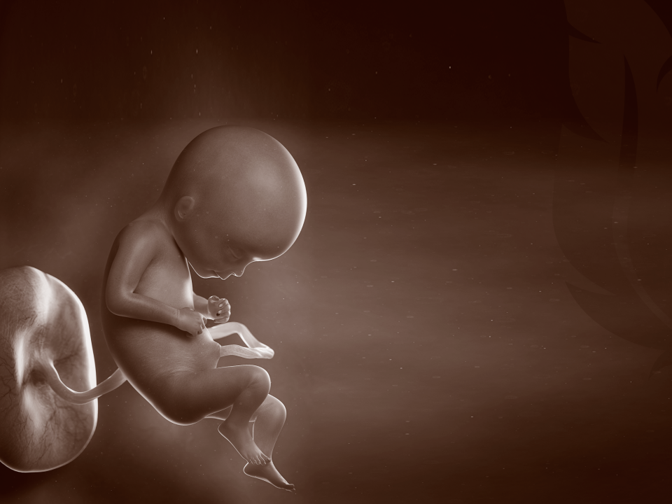
Why should we talk about prenatal development?
Notes:
To understand what happens to an unborn baby when she is exposed to alcohol, it will be helpful to take a look at pregnancy and how the baby grows inside the mother.
Then we can better understand how Fetal Alcohol Spectrum Disorder happens.

Slide 3
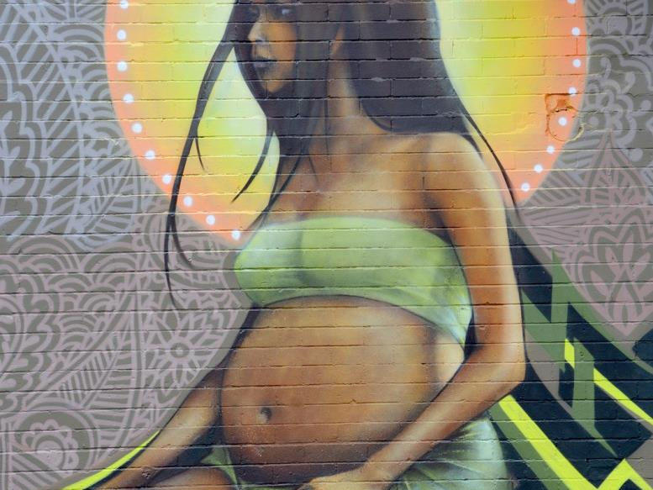
Notes:
A woman is pregnant for 9 months. During this time, the baby grows and develops until he is ready to be born.
Discussion: What do you think is important for a healthy pregnancy? Obtain responses from participants.
A healthy pregnancy includes: (in no particular order)
Taking prenatal vitamins with folic acid every day
Visiting a healthcare professional
Eating healthy food
Exercising
Getting rest
Reducing stress
Maintaining a healthy weight
Taking care of teeth and gums
Getting tested for STIs and HIV
Avoiding risky medications
Treating any existing medical conditions, such as diabetes or high blood pressure
Having healthy relationships
Not using street drugs
Not smoking cigarettes
Avoiding alcohol
Facilitated Discussion: How does your community support a woman to have a healthy pregnancy?

Slide 4
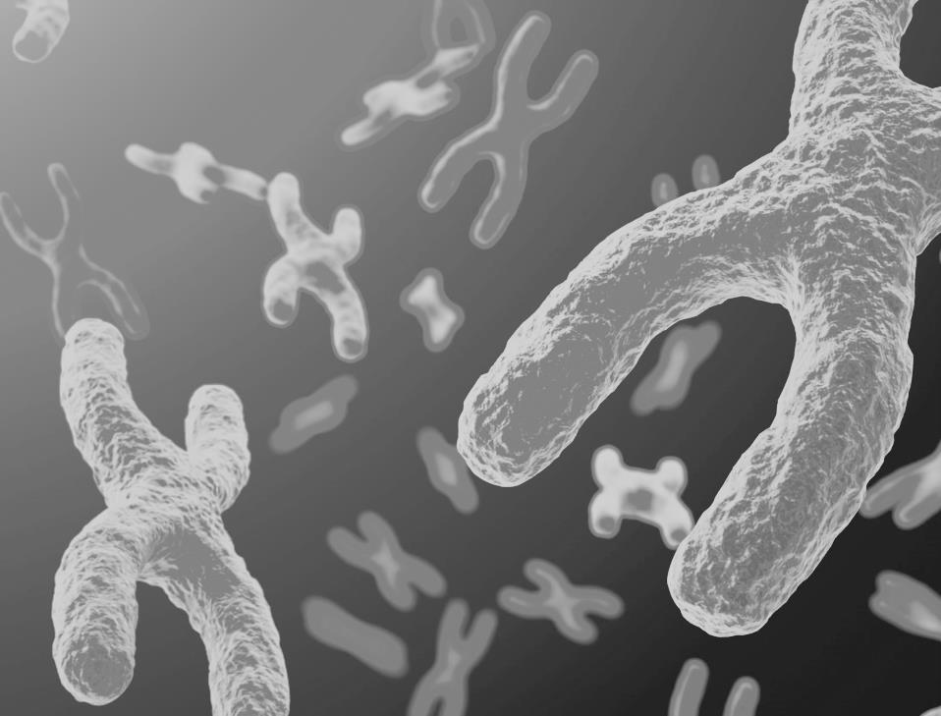
Genetics
Each parent gives 23
chromosomes to the fetus.
Notes:
Chromosomes carry genetic information for the development of the baby. This information can be thought of as a “blueprint” for development of the baby.
Chromosomes have hundreds of genes in them. Genes can be thought of as instructions. Genes decide things such as the colour of eyes and hair, and how tall a person will be.
At the time when fertilization occurs, both the mother and father give 23 chromosomes to their new baby through the egg and the sperm. The baby will then have 46 chromosomes (23 pairs).
One of these 23 pairs determines if the baby will be a boy or a girl.

Slide 5
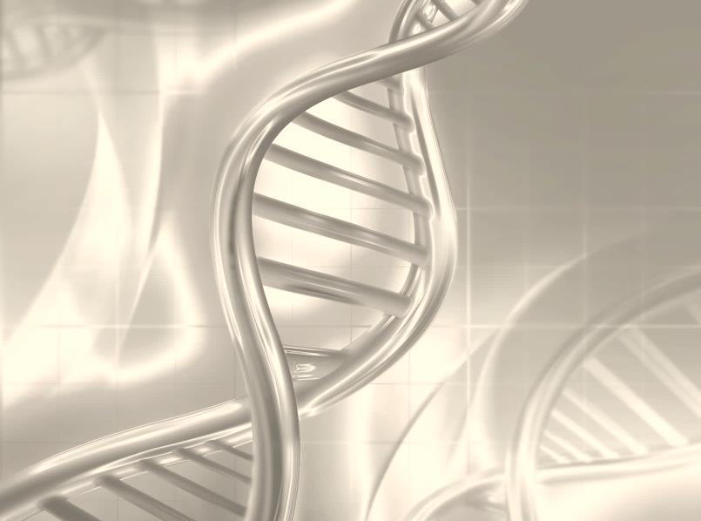
Epigenetics
Environmental factors can also affect which genes are turned on or off.
Notes:
Genes determine such things as personality, height, weight, brain development, and health.
Factors, such as the mother feeling stress or using alcohol during pregnancy, can affect what the genes do. These are called environmental factors.
Environmental factors have an effect on which genes are turned on (expressed) and which genes stay off (muted). Just like a lightbulb. This is called epigenetics.
Alcohol is one example of an environmental factor that affects what the genes do.
Genes being turned on or staying off can affect the genes in future generations as well.

Slide 6
Fetal Development
Notes:
The developing baby is called a fetus. The growth of the developing baby is called fetal development. Many people do not know a lot about fetal development.
Why is it important to understand fetal development?
When we know about healthy fetal development, it is easier to understand how drinking alcohol when pregnant can affect the fetus.
During this presentation, we will start at the very beginning; before a woman is pregnant.
You will learn about:
A woman’s menstrual cycle
How the baby is made and develops
How the baby gets nourishment and how alcohol gets to the baby
How genetics and the environment affect the baby’s development
Why sensitive or critical periods of development are important
Brain development

Slide 7
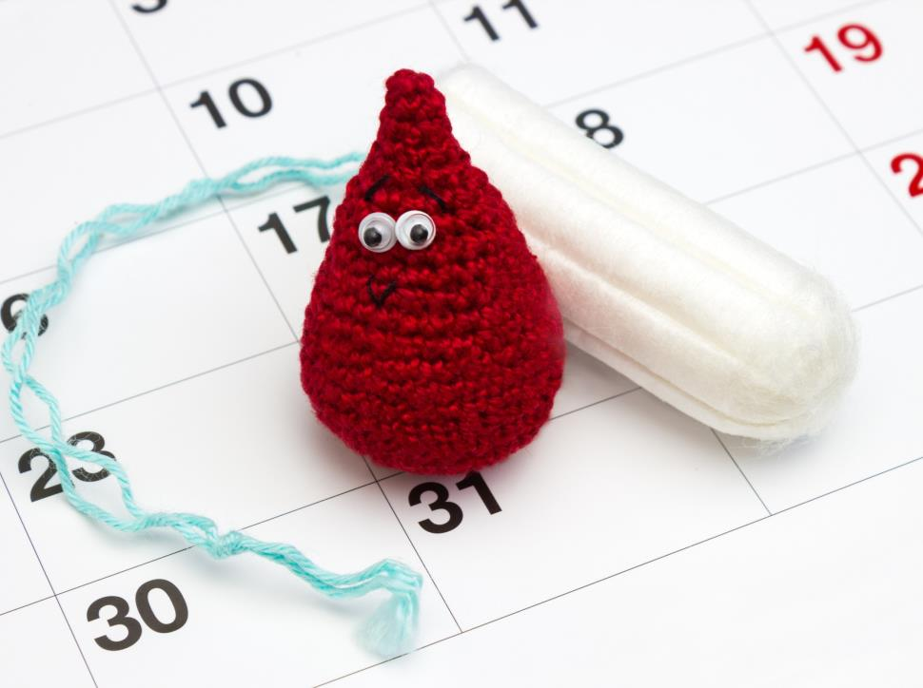
What is a Menstrual Cycle?
Notes:
Let’s start at the beginning.
Each month, most women’s bodies are getting ready to have a baby. This is called the menstrual cycle.
The menstrual cycle is different for all women. Some women’s cycles are 21 days and others 35 days.
Each menstrual cycle starts when the woman gets a period (which is called menstruation) and stops the day before her next period begins. Most periods last from 3 to 5 days. Some periods may be as short as 2 days or as long as 8 days. Each woman is different.
What happens during the menstrual cycle?
When a woman finishes her period, her uterus wall starts to thicken and gets ready to look after an unborn baby. The thickened uterus wall is called the endometrium.
Between the 2nd and 3rd weeks of the menstrual cycle, an egg is released from the ovary. The egg travels through the fallopian tube. The egg is only healthy for 24 hours. During these 24 hours, sperm can penetrate the egg, join its chromosomes with the egg’s chromosomes (fertilization), and start to develop as a baby.
If an egg is fertilized, it will attach to (or implant in) the endometrium (the wall of the uterus). We will talk more about how this happens in the next few slides.
If the egg is not fertilized or implantation does not happen, the endometrium begins to break down. When a woman gets her period, she is shedding (or getting rid of) the endometrium so that the whole process can begin again.

Slide 8
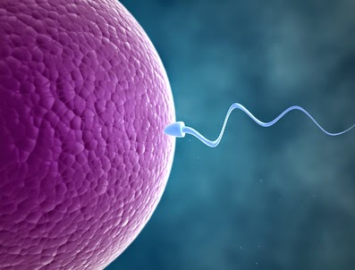
Conception
Ovum (Egg)
Sperm
Notes:
When a man ejaculates, sperm is released. These sperm have to make a long journey to get to the healthy egg. Only a few of the man’s sperm might reach the egg. When a sperm gets past the lining of the egg (penetrates the egg), fertilization occurs. Fertilization is the beginning of pregnancy. Fertilization is also called conception.
When a penis is aroused and erect, fluid containing sperm (precum) can be released. This can happen before ejaculation. Any contact between the vagina and semen can cause pregnancy. Fertilization can happen even if the man’s penis does not enter the vagina and ejaculate (have an orgasm).
If a woman has unprotected sex during the time (24 hours) that an egg is released and healthy, fertilization can happen. Pregnancy can even take place if unprotected sex happens before the egg is released. That is because sperm live in the body for up to 6 days.

Slide 9
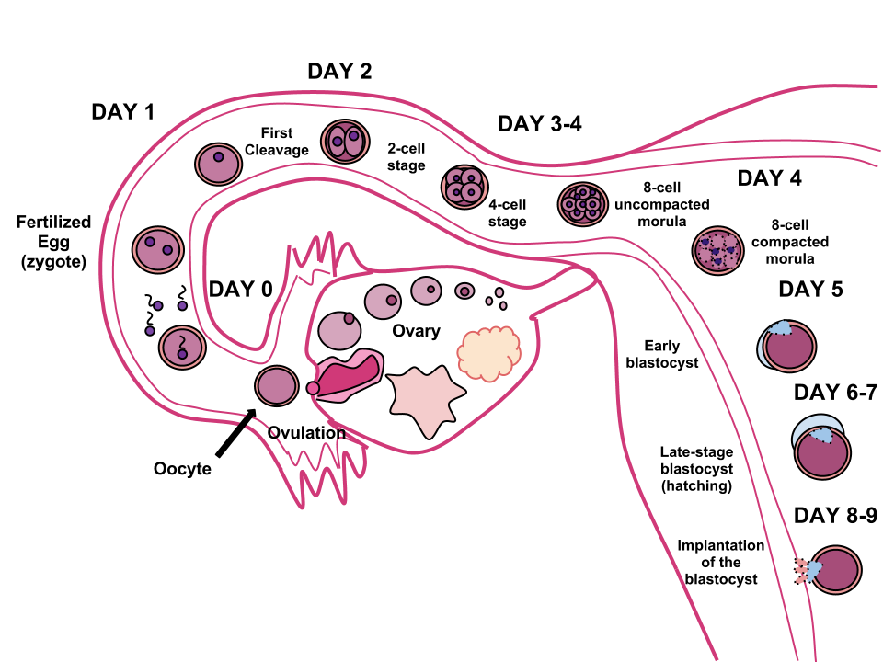
Implantation
Notes:
Once the egg is fertilized, it travels down the fallopian tube.
As it travels, the egg’s cells split and double to make more cells. This process continues throughout the entire pregnancy.
About 8 to 9 days after the egg is fertilized, the egg will attach (called implantation) to the lining of the uterus (the endometrium).

Slide 10
Yolk Sac
Notes:
For a few weeks, a yolk sac is attached to the fetus. The yolk sac has many jobs. It is part of determining if the baby is a boy or a girl, the development of the blood flow (circulatory system), digestion and use of food (metabolic processes), and getting rid of waste.
The yolk sac provides blood and food to the fetus while the placenta and umbilical cord are being formed.
After the placenta and umbilical cord are formed, the yolk sac is no longer needed. This happens at the end of the first trimester (3 months). At this time, the yolk sac gets smaller.

Slide 11
Placenta
Umbilical Cord
Notes:
Pregnancy is a natural process – a man and woman both contribute something when they have sex to grow a new life (egg and sperm).
By the third month of pregnancy, the amniotic sac, placenta, and umbilical cord are fully developed.
The amniotic sac surrounds the baby. The inside of the amniotic sac is filled with fluid (like water).
The baby is “connected” to the mother by the umbilical cord which is attached to the placenta. The umbilical cord comes out of the baby’s belly button. The umbilical cord connects the baby to the mother’s bloodstream.
The placenta is an organ that develops in a woman’s uterus during pregnancy. It’s attached to the mother’s womb or uterus (the place where the baby is growing). The placenta provides food (nutrients) and oxygen to the baby and helps to get rid of his waste.

Slide 12
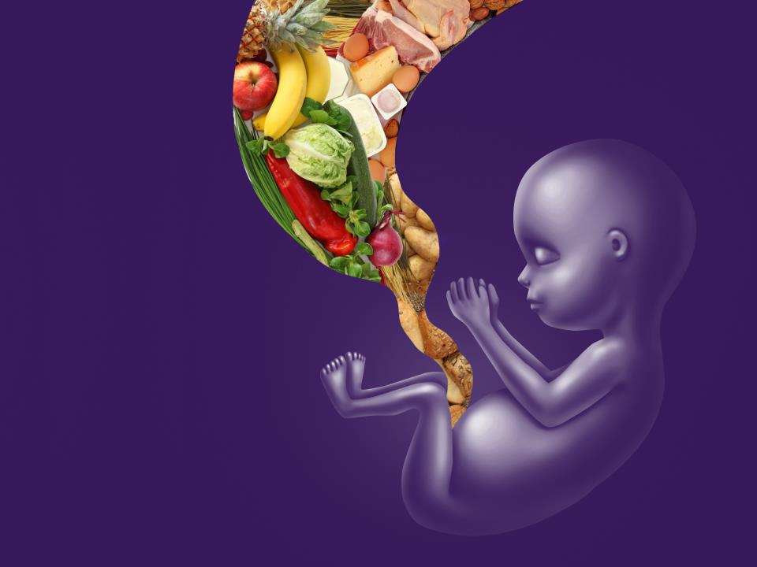
Anything a pregnant woman eats, drinks, inhales, or injects goes to the fetus.
Notes:
Anything a pregnant woman eats, drinks, inhales, or injects goes to her developing baby. When a pregnant woman drinks, the alcohol goes to her stomach and then into her bloodstream. Once it is in her bloodstream, it then travels through her body to her brain (which is how she feels the effects of alcohol) and to her liver (so it can be moved out of her body). Her baby gets the alcohol through the umbilical cord and placenta.
The mother’s body and liver can process alcohol, and once it is processed, it will leave her body. The unborn baby’s liver is not fully developed. This means alcohol stays in the baby longer than it does for the mother. It has more time to harm the baby’s growing cells.
Alcohol affects the way the developing baby’s cells grow and function. Alcohol may:
kill the cells,
interrupt them so they don’t get where they should go (mess with their GPS system), or
confuse them so they don’t do the job they are supposed to do (mess with their job description).
YouTube Video: Inside Pregnancy Weeks 1 – 9 (Baby Centre) 2:33
https://www.youtube.com/watch?v=4l9GE_eaMSs

Slide 13
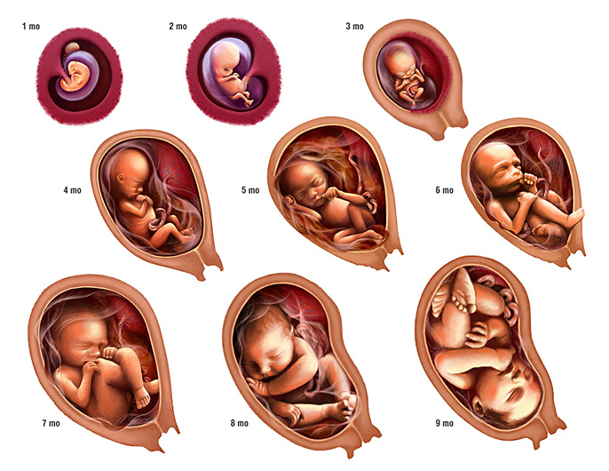
A Baby Grows … and Grows
Notes:
A baby grows and develops quickly during all 9 months of pregnancy.
The baby’s body systems are part of what develops. These systems do things such as digest food (digestive system), pump blood through the body (circulatory system), and send signals throughout the body (central nervous system). These systems will keep the baby’s body working after the baby is born and help him to survive.
YouTubeVideo: Alexander Tsiaras Conception to birth – visualized (fragment)
(Can stop at 3:00 and not show delivery)
https://www.youtube.com/watch?v=Zhf8GXfRPxA

Slide 14
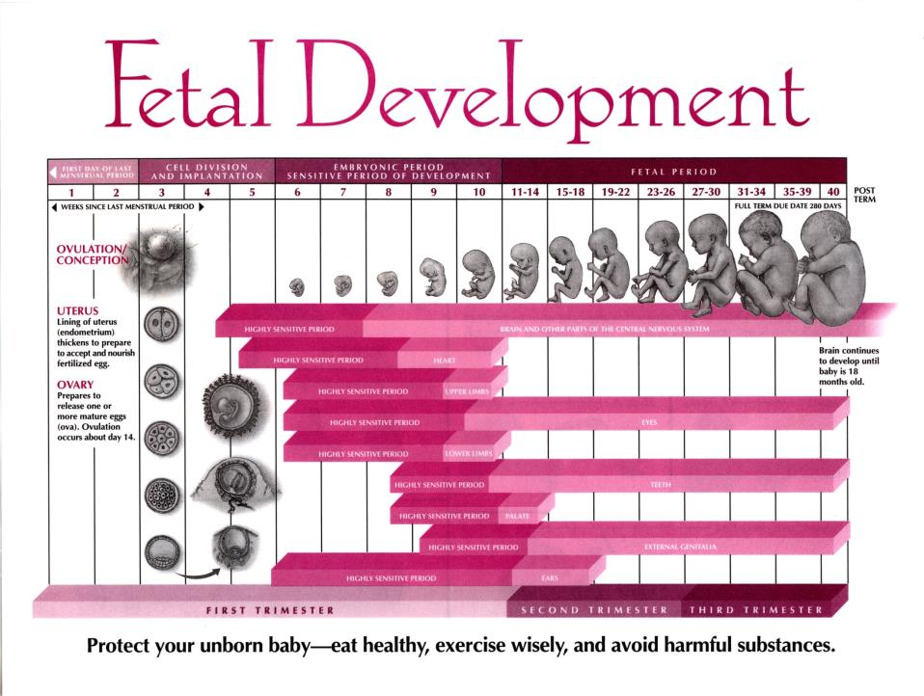
Notes:
Throughout pregnancy, different organs, limbs, and body parts are developing. There are times during pregnancy when a certain body part is in rapid development. This is called a sensitive or critical period of development. For example, the heart has a rapid period of development between the 4th and 8th week and continues to develop until the 11th week of pregnancy. During this time, the development of the heart might be harmed or changed by environmental factors, like alcohol.
This Fetal Development Chart shows the important time periods of development of some parts of the baby. As you can see, the brain and central nervous system develop over the entire pregnancy. This makes it very vulnerable to the effects of alcohol.
Activity: Look at the chart and talk about when the different parts of the body are at highest risk of being harmed by alcohol.

Slide 15
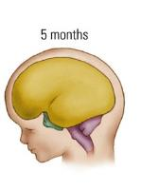
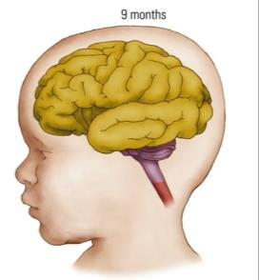
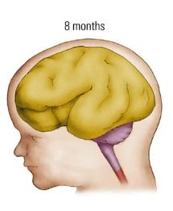
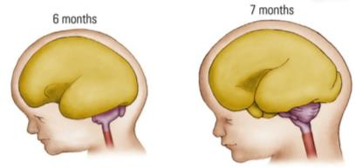
Fetal Brain Development
Notes:
The brain grows and develops for all 9 months of pregnancy. In fact, the brain continues to develop after the baby is born.
Early childhood and young adulthood are also sensitive periods of brain development. The brain is still developing around the age of 25. Alcohol can affect the developing brain during this time. That is one of the reasons young people are encouraged not to use alcohol.
^{Image: Kolb & Fantie, 2008}

Slide 16
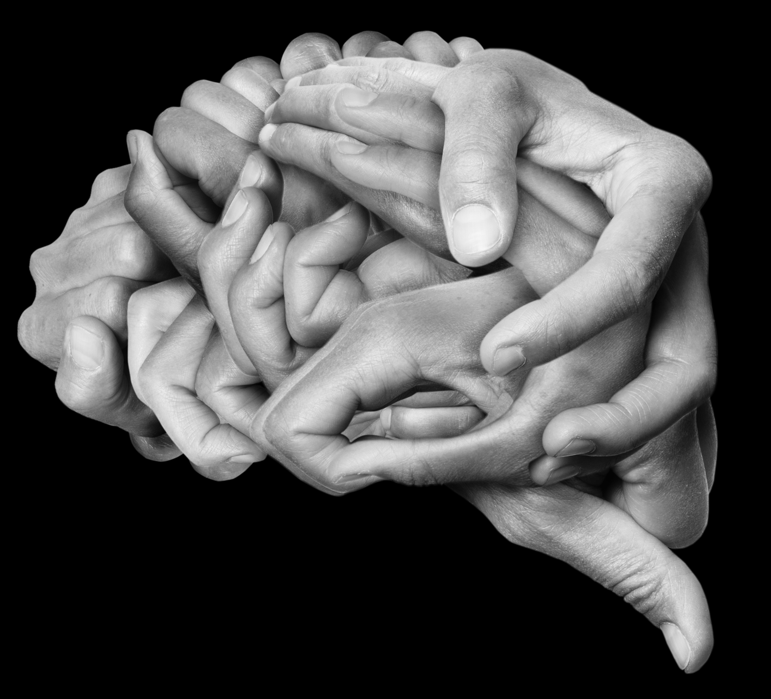
Our Brain
Notes:
Understanding a little bit about how the brain develops throughout pregnancy can help us to understand how alcohol can impact the brain.
The brain is very important to the human body. It is involved in everything we do.
Our brain controls things such as eating, breathing, and sleeping. It also controls how we think and what we remember. It helps us move.

Slide 17
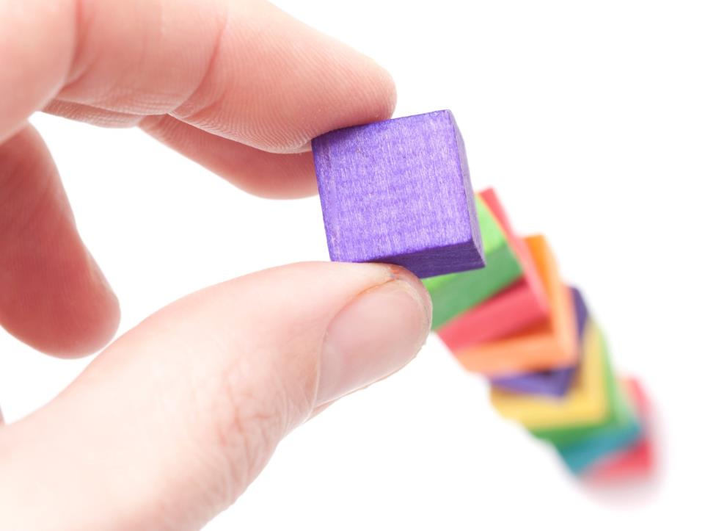
Building the Brain
Notes:
The brain is built from the bottom up (or from the brain stem upwards).
The brain is also built from the inside outwards. This growth is supported by glial cells. Glial cells are like stacking blocks or scaffolding. They help brain cells (neurons) move to their assigned spot in the brain so that they can do their job.
Some brain cells do not have to travel far. Others have to travel farther to the part of the brain where they belong. Each brain cell has a job description and a GPS system. They know what job they have to do, and they know how to get to the place where they belong to do that job.
Parts of the brain do not function by themselves. They all work together.

Slide 18
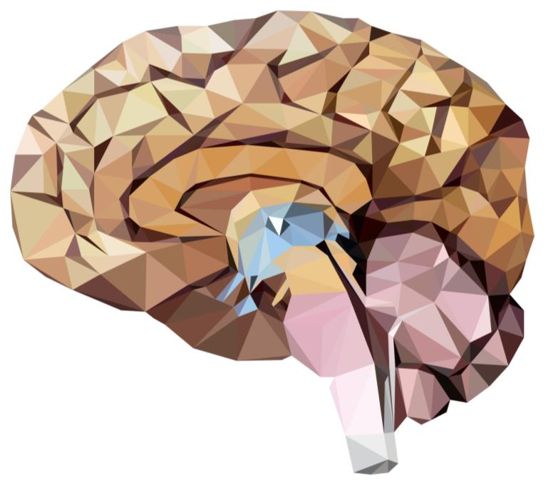
Brainstem
Hindbrain
Notes:
The first part of the brain to develop is the hindbrain, which includes the brainstem. This area controls the important body systems needed to survive. These include breathing (respiratory), maintaining a heart rate (circulatory), feeling hungry or full (digestion), and getting rid of waste (peeing and pooing). Some people nickname it the primitive brain or dinosaur brain.

Slide 19
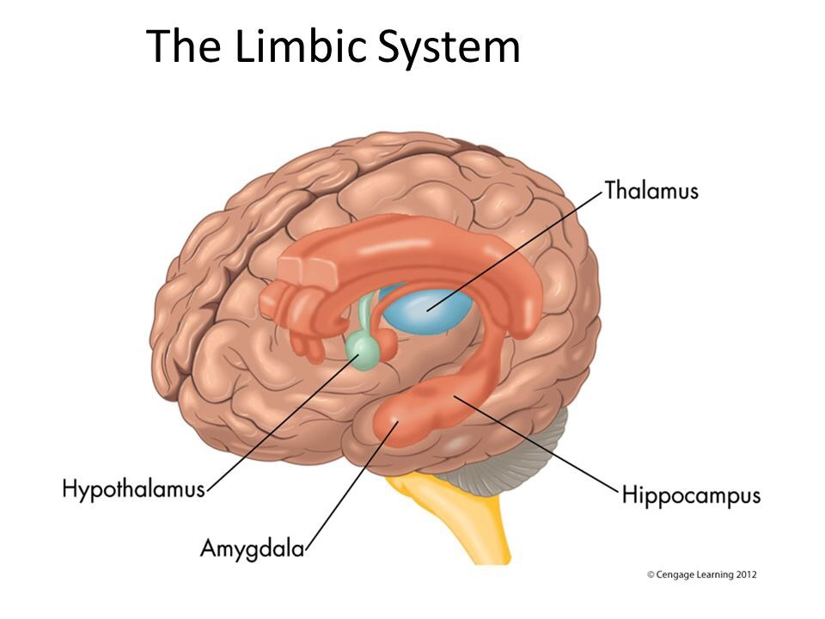
Notes:
Just above the brain stem, at the core of the brain, is a group of structures that together are known as the limbic system. These structures do a lot of different things. The limbic system acts as a relay station for information coming and going from the brain. It regulates our body states, such as hunger and alertness, and stores memories. It determines our emotional responses, and affects how we respond to stress and danger. The limbic system is sometimes called the feeling brain or monkey brain.
If the limbic system (or feeling brain) is harmed by alcohol, it may have trouble taking in and understanding information. For example, when something happens to you, your limbic system tells you whether you are safe or not. If you do not feel safe, your “fight or flight (run)” response is activated. If your limbic system is harmed by alcohol, it might not be able to tell if something is safe or not.

Slide 20
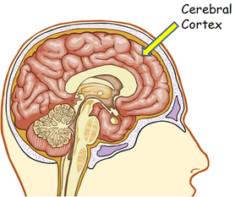
Notes:
The part of the brain that takes the longest to develop is the cerebral cortex. The cerebral cortex looks after thinking, making plans, meeting our goals, and regulating our feelings. This area can turn short-term memories into long-term memories. It creates connections between the different parts of your brain. It is like the CEO of a company, managing and running things. It is sometimes called your thinking brain or owl brain.
The cerebral cortex or “thinking brain” depends on the other parts of the brain to help it do its job. When the other parts have been harmed, it is more difficult to do thinking and reasoning.
YouTube Video: Areas of the Brain (Sentis Brain Animation Series) 3:07
https://www.youtube.com/watch?v=5_vT_mnKomY&list=PL53nCCeNj-RQDhbjE9LjvnFad-wdB5bw7&index=3&t=0s

Slide 21
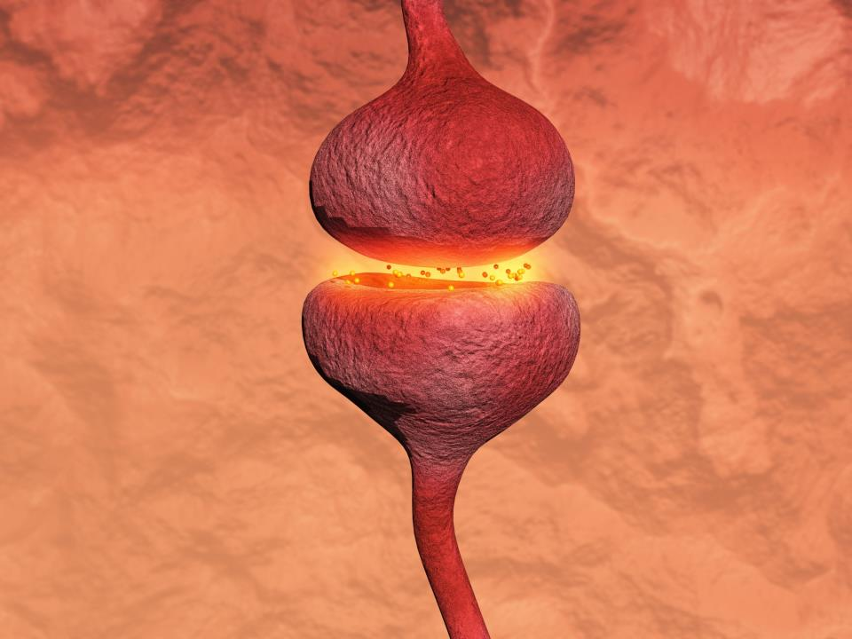
Neurotransmission
Notes:
For the brain and body to function, they need to be able to talk to each other. This is done through the development of links between millions of different nerve cells (neurons). This is called neurotransmission. This image represents one neuron. There are billions of them in a brain, sending impulses, or messages, to each other.
YouTube Video: How the Brain Works (The Sentis Brain Animation Series) 1:37
https://www.youtube.com/watch?v=XSzsI5aGcK4&list=PL53nCCeNj-RQDhbjE9LjvnFad-wdB5bw7&index=2&t=0s
When you were a child, did you ever play a game of telephone, where you and your friends all stood in a row and one person started by whispering a sentence into the ear of the person next to them and so on down the line? Then the last person would say out loud what was whispered in his ear to see if it was the same as what the first person said. Typically, it had changed dramatically. This game demonstrates how messages can get mixed up. In our brains, the messages are supposed to come out clear and accurate.
When alcohol is present during brain development, neurotransmission may not be clear and accurate.

Slide 22
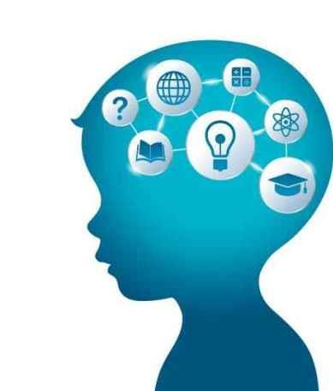
Alcohol can Harm the Developing Brain.
Notes:
Because the brain is developing and growing throughout the entire pregnancy, it is the organ most likely to be affected by alcohol.
When alcohol is used in pregnancy it can have this effect on developing cells:
Developing brain cells can get mixed up or lost; they do not go to the area of the brain that needs them. Their GPS system is broken.
Developing brain cells that have to travel a long distance to get to their assigned part of the brain are more likely to be affected by alcohol than those that have to move a shorter distance.
Developing brain cells are changed so they do not work properly even if they go to the right part of the brain. It is like their job descriptions have been deleted. They are there, but they don’t know what to do.
Brain cells may die. This means there aren’t as many cells in some parts of the brain.
This impact on the brain’s development may not be noticeable until a child is older and in school. The impact will be different for each individual, depending on when alcohol is used in pregnancy and how much is used.

Slide 23
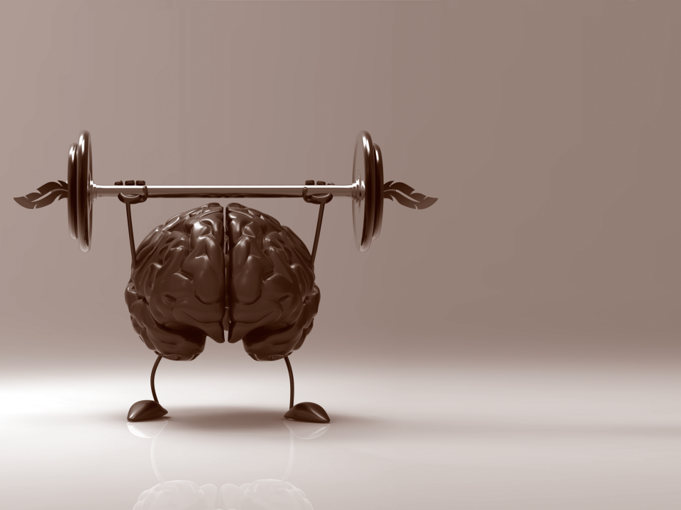
Neuroplasticity
Between the ears, it’s a construction zone.
Notes:
The good news is that the brain is continually changing and adapting. This is called neuroplasticity.
Although areas of the brain may be affected before birth, the brain has an amazing way of working around this.
The way the brain ends up working may not be as good as it could have been had it not been affected by alcohol. It may take a lot of practice to learn something in a different way, but the brain can learn new ways of working.
YouTube Video: Neuroplasticity (Sentis Brain Animation Series) 2:04
https://www.youtube.com/watch?v=ELpfYCZa87g

Slide 24
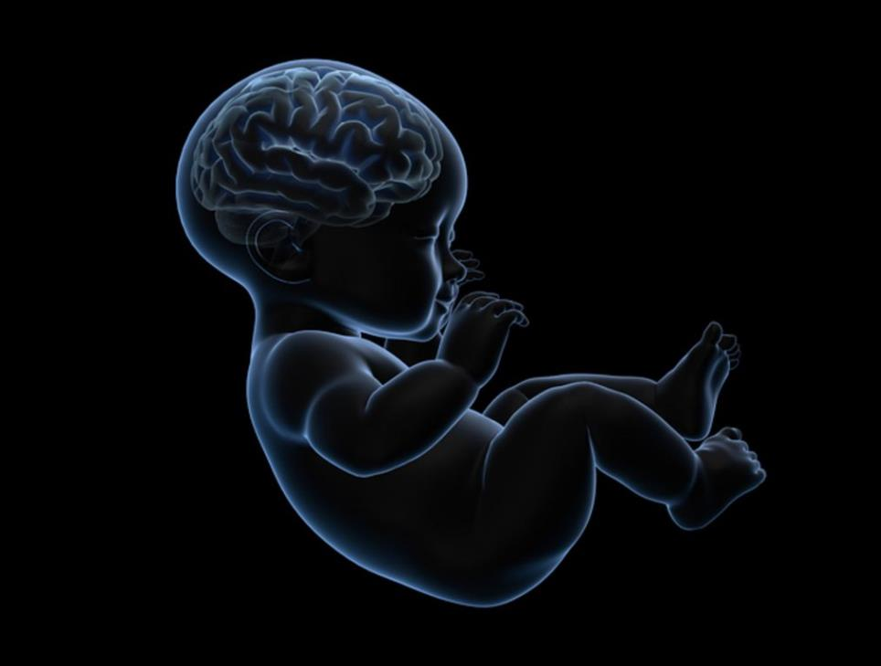
Alcohol can affect any part of the developing baby.
Notes:
Alcohol can affect any part of an unborn baby’s developing body. To protect the baby from alcohol, it is best to stop drinking alcohol before getting pregnant, and through all 9 months of pregnancy.

Slide 25
Fetal Development
Growth of the fetus starts at conception.
At times during pregnancy, certain body parts or systems develop quickly and are very vulnerable.
The brain and nervous system develop throughout the whole pregnancy.
References are available on request:
info@skprevention.ca
Notes:
In conclusion:
The growth of the fetus starts at conception.
There are times during pregnancy when certain body parts or systems are developing quickly. These parts and systems are very vulnerable at this time.
The brain and nervous system are developing throughout the whole pregnancy.

