Slide 1
COPING STRATEGIES
DURING COVID-19
Staying at home during Covid-19 can increase anxiety, but it’s important to make good food choices
Beware that alcohol can reduce your body’s ability to fight COVID-19.You can use a calendar to monitor your drinking level or try an app like ‘Try Dry’
Go on YouTube to find fun exercises or learn a new skill. You can study Cree or Dene online.
If you are feeling healthy, you can go outside for walks, runs and bike rides. Enjoy the change of season!
We are going through this pandemic together and reaching out to family and friends is important to support each other
Are you feeling anxious and are experiencing panic attacks during COVID-19? Call 811 (open 24 hours)
to talk to a professional. You can also make an appointment at your local clinic

Slide 2
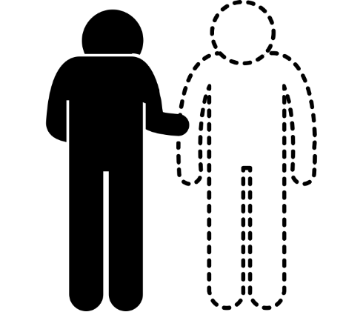
MANAGING ALCOHOL WITHDRAWAL
DURING COVID-19
If you drink heavily, drinking less or not at all may make you feel sick and could possibly lead to serious health problems
If you have a fast or irregular heartbeat, you start to vomit or have diarrhea, have sweats, chills or start to shake you need to call a doctor or 811
If you start to see or hear things that are not there, you need to call 911. These symptoms are dangerous, possibly life threatening, and you need to get help immediately
Slowly reduce the amount of alcohol you drink over time with guidance from a doctor or wellness worker
When looking to cut back or quit drinking, there are medications that can help with cravings. Call your doctor to discuss these options
It’s important to recognize the signs of alcohol withdrawal in yourself or others.
If you want to cut back or quit, call your local clinic. There are supports to help you do this safely.

Slide 3
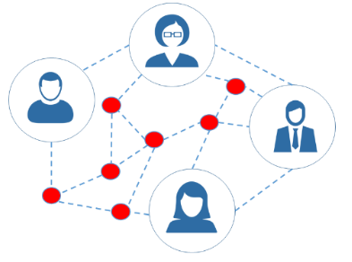
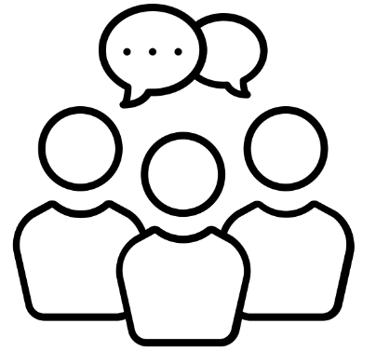
THE DANGER OF PARTYING
DURING COVID-19
Young and healthy
people are not immune!
Partying puts you and others at risk.
Sharing cups/bottles or cigarettes/vapes is dangerous
Stay home and avoid
visiting loved ones. If you’ve been drinking, do not drive
Alcohol affects your immune system by reducing its ability to defend against infections
Keep in touch with
family and friends over the phone or online
If you see someone hosting a party or large gathering and want to report it, call the RCMP non-emergency line at: 310-7267

